Slide 1
FROZEN SHOULDER/ Periarthritis shoulder/ stiff shoulder/ adhesive capsulitis
Dr. Goutami Katage Shah
Dept. of Musculoskeletal Physiotherapy
MGM Institute Of Physiotherapy
Chh. Sambhajinagar

Slide 2
Contents
Definition
Causes
Pathology
Clinical features
Types
Investigations
Management

Slide 3
CAUSES
Post operative stiffness
Age
injury
Diabetes
CABG | Radical mastectomy | Post op shoulder cases

Slide 4
Primary - Onset is generally idiopathic (it comes on for no attributable reason)
Secondary - Results from a known cause, predisposing factor or surgical event.A secondary frozen shoulder can be the result of several predisposing factors. For example, post surgery, post-stroke and post-injury. Where post-injury, there may be an altered movement pattern to protect the painful structures, which will in turn change the motor control of the shoulder, reducing the range of motion, and gradually stiffens up the joint.

Slide 5
Three subcategories of secondary frozen shoulder include:Systemic (diabetes mellitus and other metabolic conditions);
Extrinsic factors (cardiopulmonary disease, cervical disc, CVA, humerus fractures, Parkinson’s disease)
Intrinsic factors (rotator cuff pathologies, biceps tendinopathy, calcific tendinopathy, AC joint arthritis).

Slide 6
PATHOLOGY
Contracture of any of the soft tissue stabilizers
Like GH ligament, coracohumeral ligament, shoulder capsule, RC musculature and tendons
Results in constriction of GH joint
Leading to clinical picture of adhesive capsulitis

Slide 7
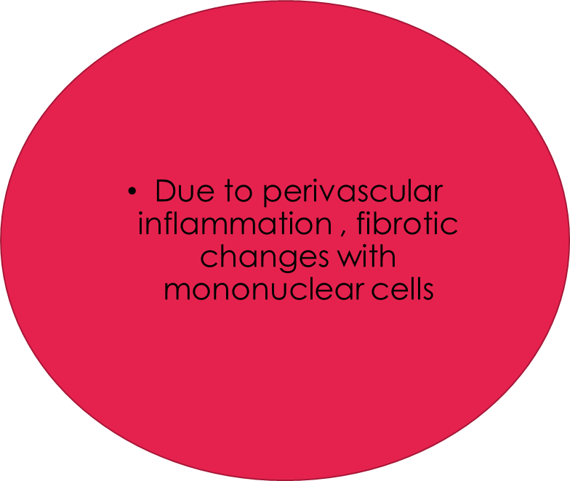
The capsule gets markedly thickened
There is paucity of synovial fluid within the joint
Primary AC
Leads to patchy synovitis
Chronic AC
Leads to thickening of coracohumeral ligament and rotator interval tissues

Slide 8
Synovium reveals
Marked increase in severe cytokines
Leading to capsular fibroblasts
Leading to collagen deposition

Slide 9
The pathophysiology of frozen shoulder involves a diffuse inflammatory synovitis
with subsequent adherence of the capsule and a loss of normal axillary pouch and joint volume,
which in turn leads to a noteworthy loss of motion of the shoulder joint.
The contracture of the capsule is thought to result from the adhesion of the capsular surfaces or fibroblastic proliferation in response to cytokine production.

Slide 10
The capsule of the shoulder is thickened in adhesive capsulitis
and a mild chronic inflammatory infiltrate and fibrosis maybe present.
The adhesive capsulitis is primarily a fibrosing condition affecting the capsule (fibrous bag around a joint)
This causes tightness of the coracohumeral ligament (one the ligaments attaching the shoulder to the humerus)
which in turn leads to restriction of passive movement of the shoulder especially the external rotation

Slide 11
STAGES OF ADHESIVE CAPSULITIS

Slide 12
CLINICAL FEATURES
Pain
Stiffness
Tenderness
Pain worst at night
Stiffness limited to abduction and internal rotation
Later pain present at all times and all movements are severely limited.
FREEZING PHASE – Dull aching pain not extending till elbow
FROZEN PHASE- Radiating pain beyond elbow. Pain severe intensity. Emotional stress and depression.

Slide 13
GOALS
To reduce pain
To improve mobility of the joint
To increase extensibility of thickened and contracted capsule
To improve GH rhythm
To increase strength
To achieve joint play

Slide 14
Patient education
To reduce pain-
1. Ultrasound- pulsed mode , Intensity- 1.5W/cm square,
Time- 10 min , once a day 6 days a week for 4 weeks
2. LASER- Parameters – 850nm wavelenth, 3min/session
3. TENS- Sitting, continuous mode, frequency 100Hz
Pulse duration- 0.05-0.7ms, time- 20min
Placement- over painful points

Slide 15
4. Moist pack 15 min- as well for spasm
Patient education- 1.Describe the natural course of disease
2. Activity modification to encourage , pain free ROM

Slide 16
Conventional PT programme-
Pendulum exercises
Wand exercises
Shoulder ladder exercise – sh flexion, abduction
Shoulder pulley ex- sh flexion, abduction
2 sets , 10 repetitions
Freq- 5times/week
Duration- 4 weeks

Slide 17
MET- 10 sec contraction 5 sec relaxation
Repetitions- 5times/session
Duration- 3 sessions/ week for 4 weeks ( 12 sessions)
Scapular mobilization-
PP- Side lying, affecte shoulder up
Superior and inferior
Upward and downward rotation
10 sets 10 repetitions , rest interval 30 sec
Duration- 2 times a week for 8 weeks

Slide 18
Cyriax mobilization- Deep friction massage , 15min, 3 times/week for 2 weeks
Maitland mobilization-
Glides – Inf , PA, AP
2-3 glides/s , sets – 5 , freq- 3 times/week for 4 weeks
Mulligan mobilization- Sets and repetitions: 3 sets of 10 repetitions, Rest interval: 30 seconds between each set, Frequency: 5 days/week Duration: 3 weeks.

Slide 19
Rotator cuff strengthening:
Exercises:
External rotation in side-lying and standing
Scaption in standing
Internal rotation in supine.
Strengthening exercises can be performed isometrically. And isotonically according to pain.
repetitions: 10 repetitions of for 3 sets
frequency: 4 times/week
Duration: 3 weeks

Slide 20
PNF contract relax technique:
For internal rotators (subscapuaris)
7 seconds contraction and 15 seconds relaxation in external rotation.
Repetitions: 5
Frequency: once in a day for 2 days/week
Duration: 4 weeks.

Slide 21
D2 flexion and extension pattern:
Repetitions: 8, 2 sets per session.
Each repetitions held for 5-10 seconds
Frequency: 1 session/day
Duration: 2 weeks

Slide 22
Hold-relax:
For improving D2 flexion pattern.
10 seconds antagonist muscle contraction flowed by voluntary relaxation.
Repetitions: 5 times/session.
Frequency: once in a day., 3days/week, for 4 weeks

Slide 23
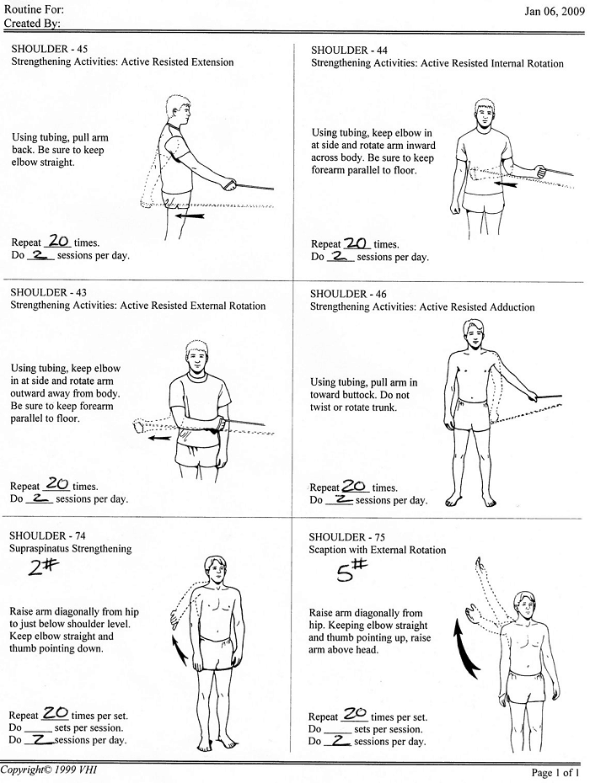
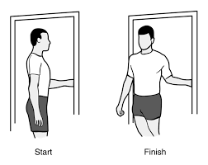
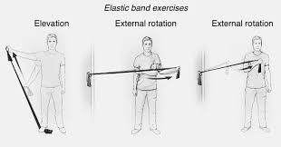

Slide 24
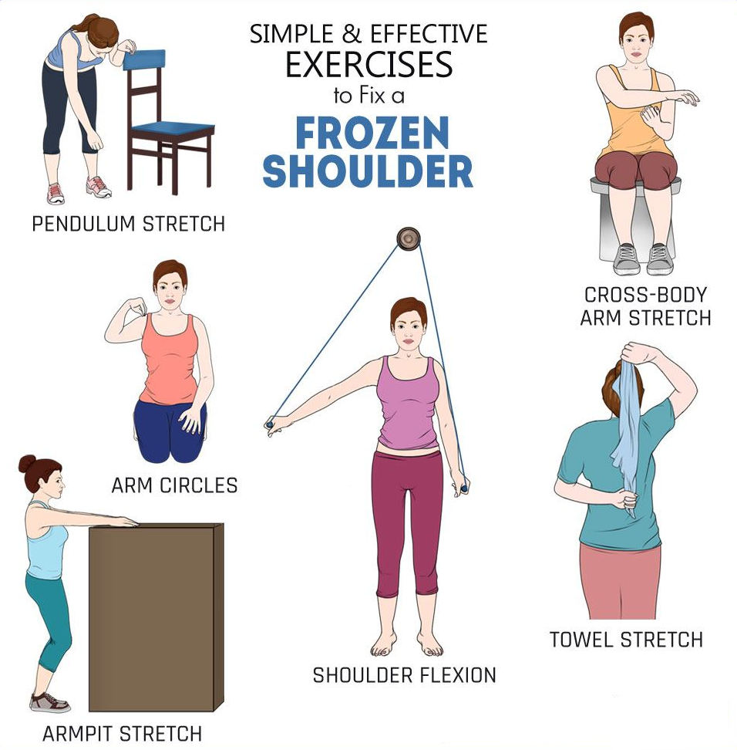
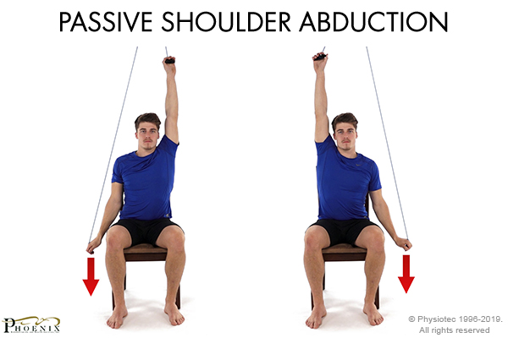

Slide 26
Strectching exercise
Scapular stabilization exercises

